Slide 1
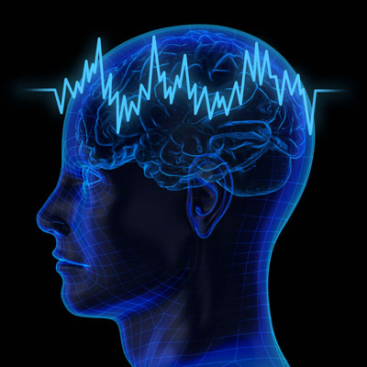
COMPUTING WITH RHYTHMS: THE SEARCH FOR GENERAL TRAINABLE OSCILLATORY DEEP NEURAL NETWORKS
V. Srinivasa Chakravarthy
IIT Madras.

Slide 2
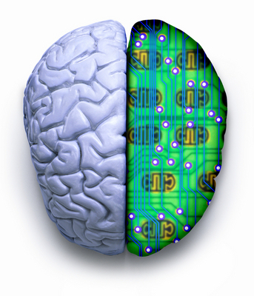
Laboratory for Computational Neuroscience, IITM
To build a
Simplified model of the Whole Brain
and
Use it to develop applications in
Medicine and Engineering.

Slide 3
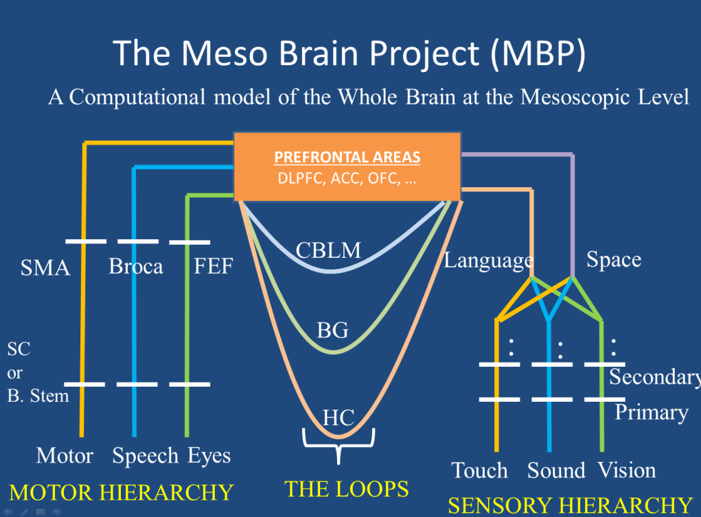

Slide 4
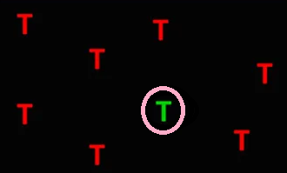
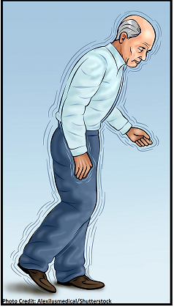


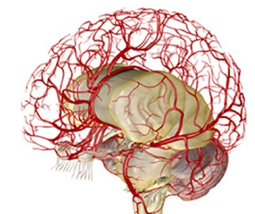
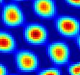
LABORATORY FOR COMPUTATIONAL NEUROSCIENCE, IITM
Stroke
Deep
Vision
Basal Ganglia/
Parkinsons
CNS
Neuro-vascular
Spatial
Navigation
Neural
Oscillators

Slide 5
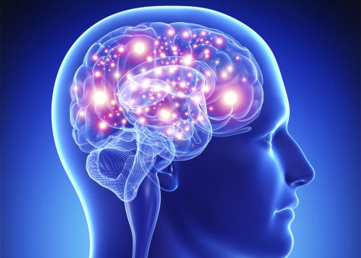
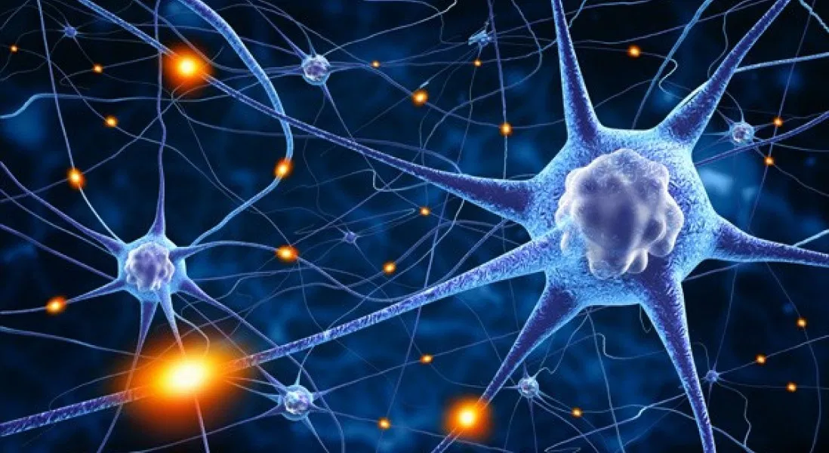
The Brain is a network of Neurons
Neurons communicate with each other by exchanging
electrical signals

Slide 6
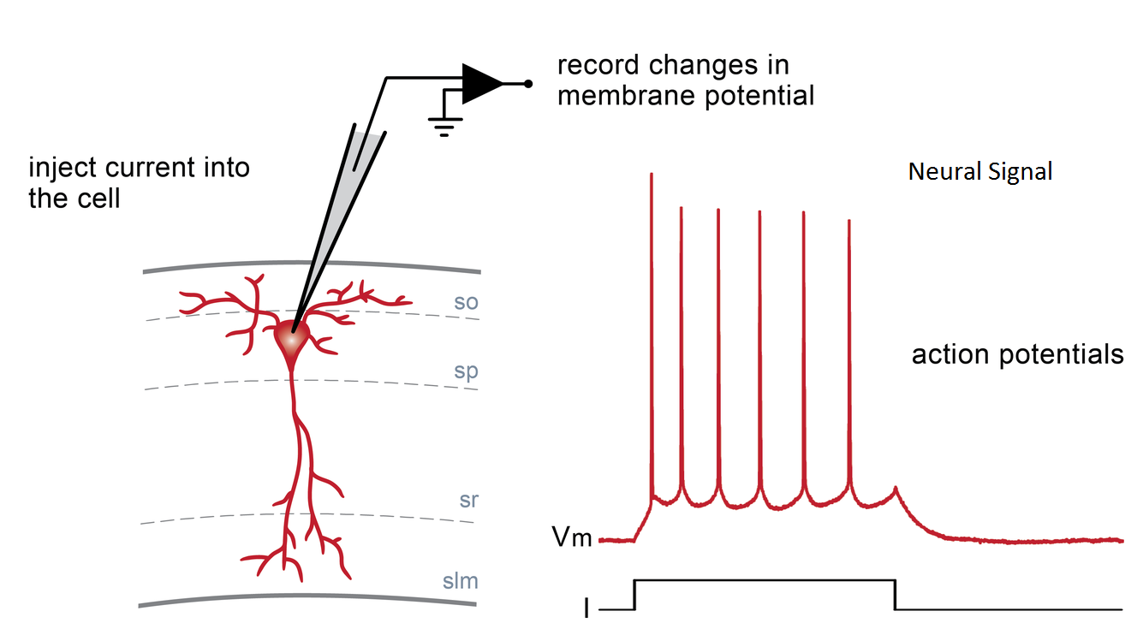

Slide 7
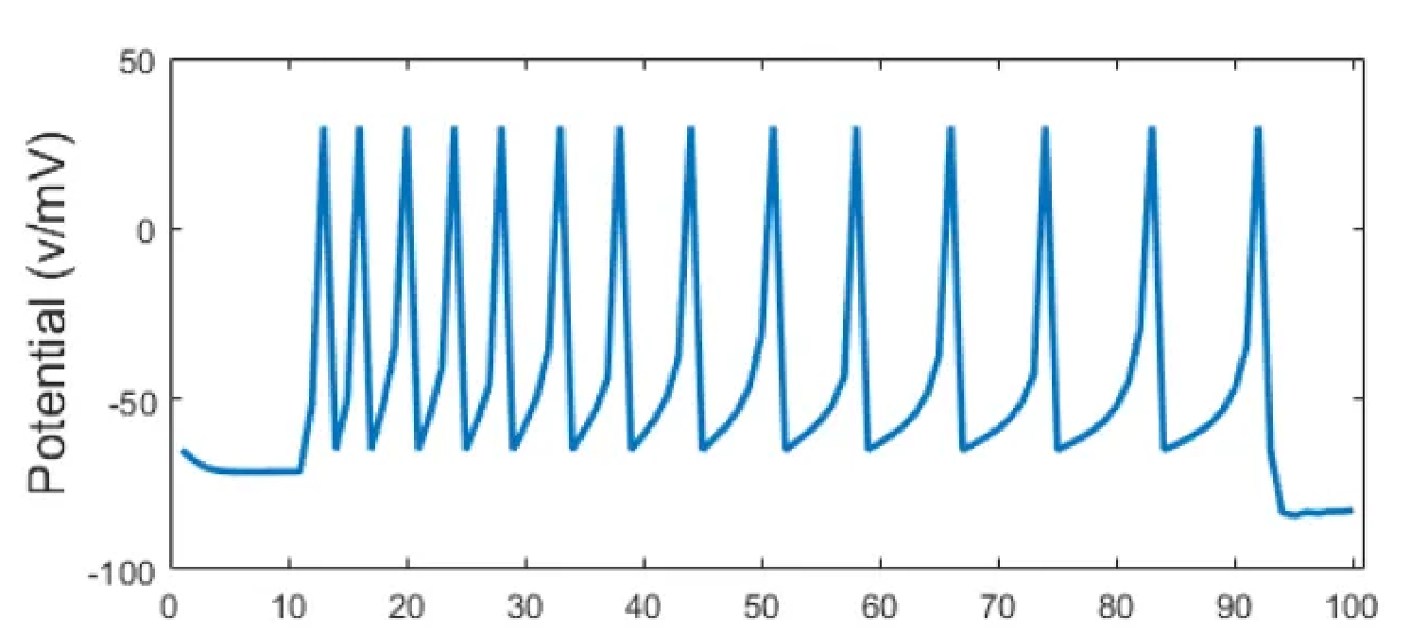
WHAT IS THE NEURAL CODE?
How do you mathematically describe the information present
in the electrical spiking activity of a neuron?

Slide 8
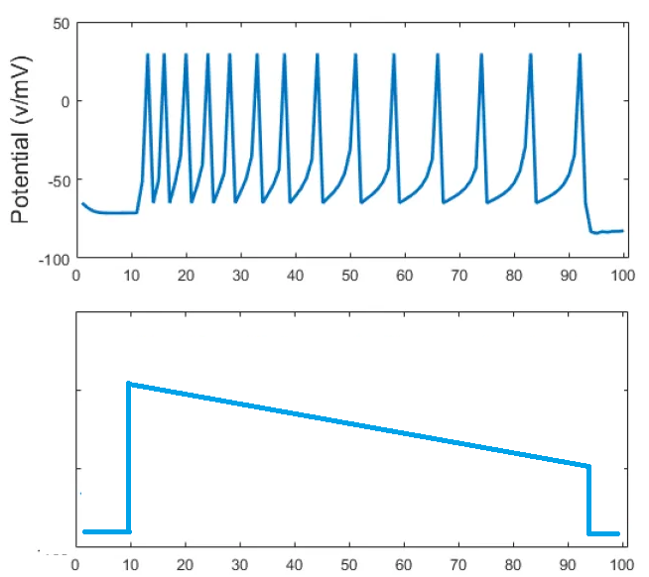
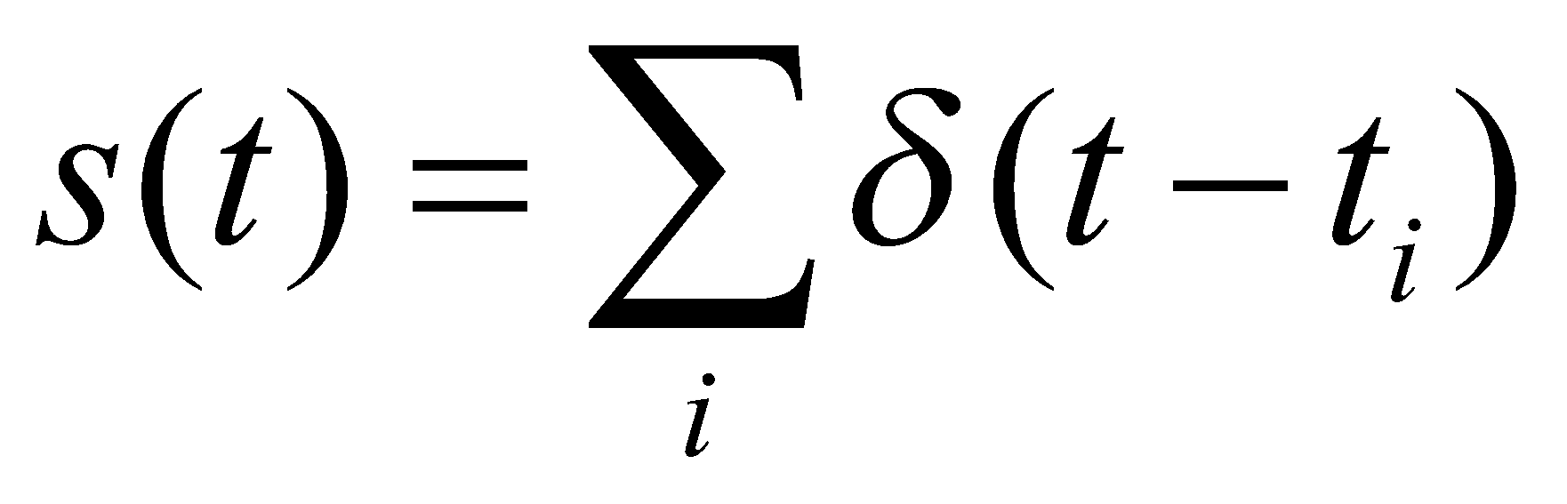
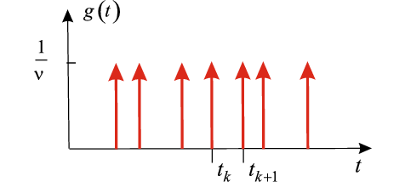
TWO THEORIES
Spike code
Rate Code
Information is present in the frequency (rate) of the spikes
Information is present in the times of occurrence of the spikes

Slide 9
TWO KINDS OF NEURON MODELS
Spiking neuron
Rate coded neuron
Used often to model brain function
Used more in artificial, engineering domains
Eg. Deep neural networks

Slide 10
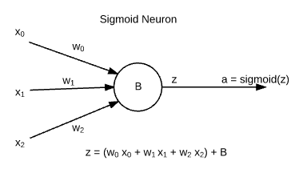
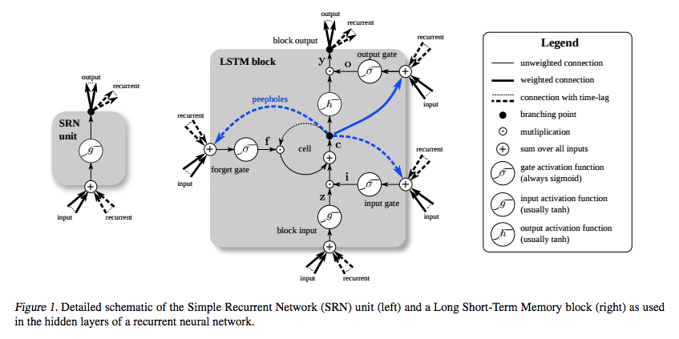
RATE-CODED NEURON MODELS
Sigmoidal neuron - static, rate-coded
Used in
Deep
Neural
Networks
Relu neuron - static, rate-coded
Long Short-Term Memory block:

Slide 11
DEEP LEARNING/AI
The aim of Deep learning/AI is to reproduce human intelligence.
They are inspired by the human brain in a general sense

Slide 12
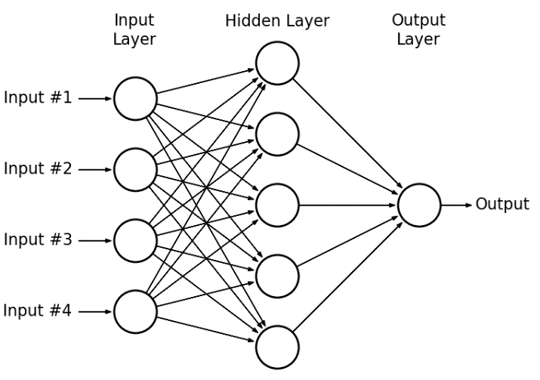
NNS AND DEEP NNS
1980s-1990s: Multilayer perceptrons and backpropagation
Deep learning – 2006
Powerful computational
properties.
Universal approximation
results
Multi-layer Perceptron

Slide 13
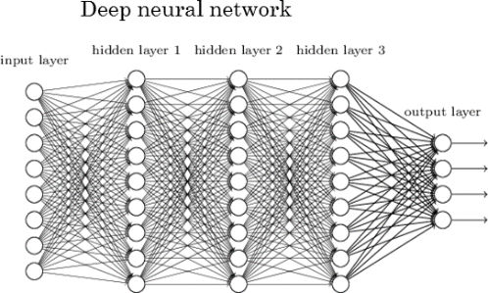
DEEP NEURAL NETWORK
The aim of Deep learning/AI is to reproduce human intelligence.
They are inspired by the human brain in a general sense

Slide 14
SPIKING NEURON MODELS
Leaky Integrate and fire neuron (1 variable)
Izhikevich neuron (2 variables)
Hodgkin-Huxley neuron model (4 variables)
Biophysical neuron models (large number of variables)

Slide 15
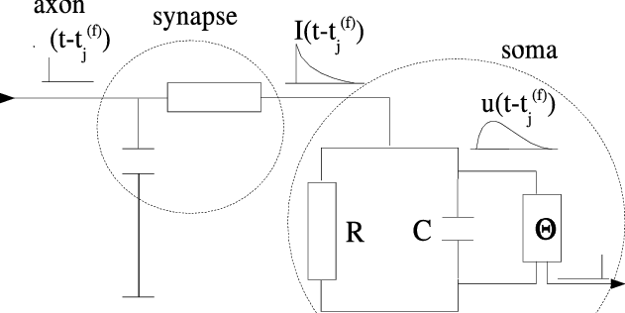
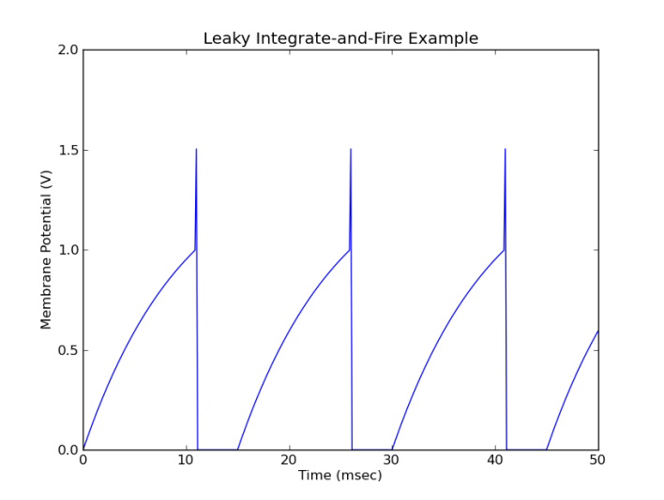
LEAKY INTEGRATE AND FIRE NEURON MODEL

Slide 16
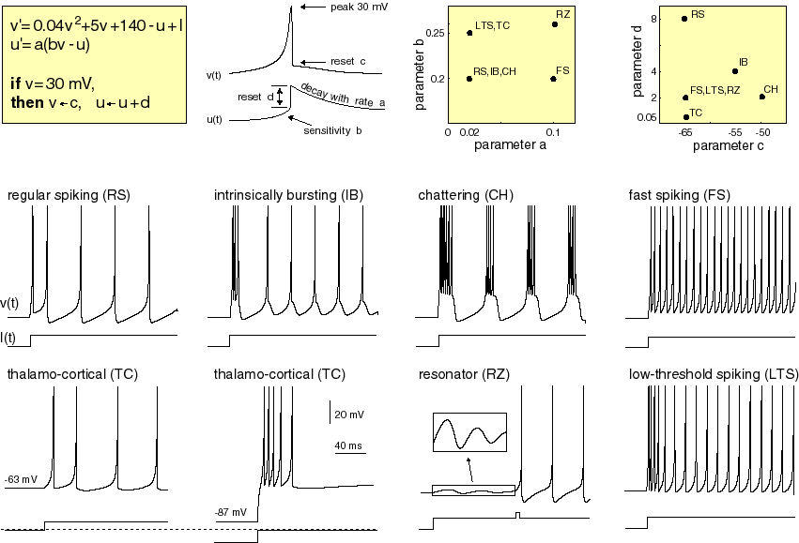
IZHIKEVICH NEURON MODEL
https://www.izhikevich.org/publications/whichmod.htm

Slide 17
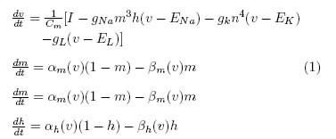
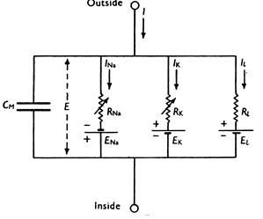
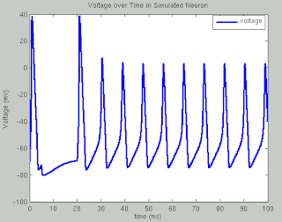
HODGKIN-HUXLEY NEURON MODEL
Hodgkin-Huxley Model (Example of a “point neuron” model)
Hodgkin & Huxley
Were awarded the
Nobel Prize in 1963

Slide 18
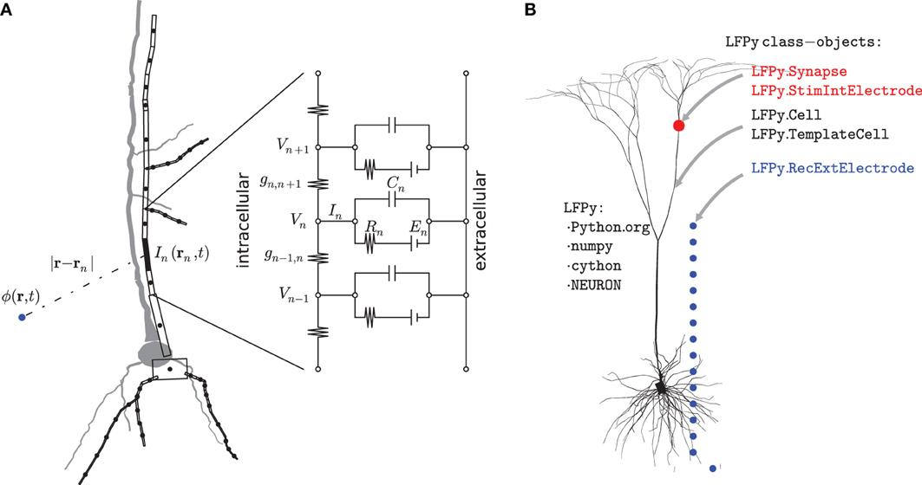
BIOPHYSICAL NEURON MODEL
Simulate the entire neuronal arbor
https://www.frontiersin.org/articles/10.3389/fninf.2013.00041/full

Slide 19
WHERE IS THE SWEET SPOT?
Rate-coded
Neuron
Model
Detailed Spiking
Neuron
Model
Conductance-based models (HH)
Biophysical models
Simplified spiking neuron models
- Sigmoid neuron
- LSTM etc
TOO ARTIFICIAL
TOO REAL?
Is there a middle ground?

Slide 20
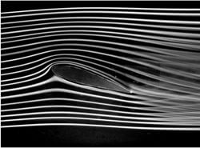
THE QUESTION OF THE RIGHT LEVEL
Example:
Aircraft wing in a wind tunnel
Study fluid flow using Navier Stokes Equation
FLUID is an abstraction
FLUID is NOT molecules

Slide 21
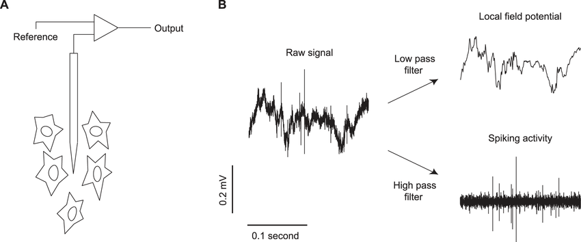
FROM SINGLE NEURON TO NEURAL ENSEMBLE
Local field potential
activity of a local neural population
Neural field models:
Coarse-grained models of spatio-temporal evolution of neural tissue (eg cortex)

Slide 22
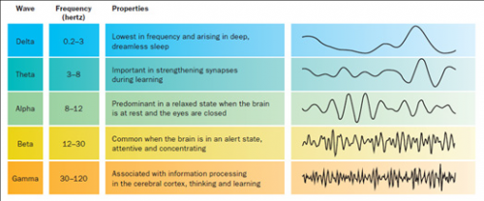
NEURAL "WAVES” – ELECTROENCEPHALOGRAM (EEG)

Slide 23
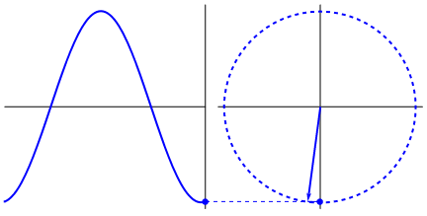
DO MODELS OF NEURAL OSCILLATORS OCCUPY THAT IDEAL MIDDLE GROUND?
“Synchronous activity of oscillating networks is now viewed as the critical ‘middle ground’ linking single-neuron activity to behavior” - (Buzsaki and Draghun, Science 2004)

Slide 24
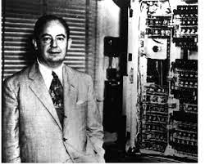
OSCILLATOR-BASED COMPUTER HARDWARE
Oscillator phase can be used to realise Boolean computations – von Neumann 1954.
Has a patent based on this concept
Oscillator-based computing realized with nanoscale, highly efficient oscillators have the potential to yield truly revolutionary devices (Csaba and Porod 2019).

Slide 25
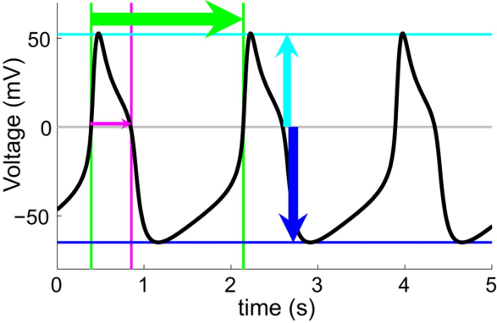
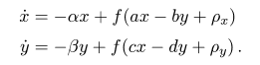
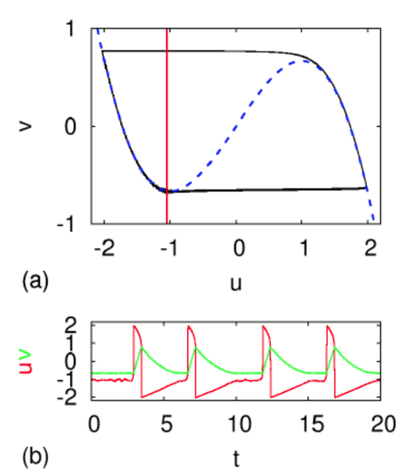
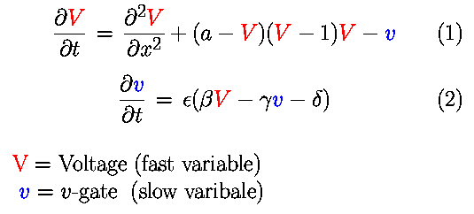
NEURAL OSCILLATOR MODELS (TYPICALLY 2 VARIABLE MODELS)
Wilson-Cowan model
FitzHugh - Nagumo model

Slide 26
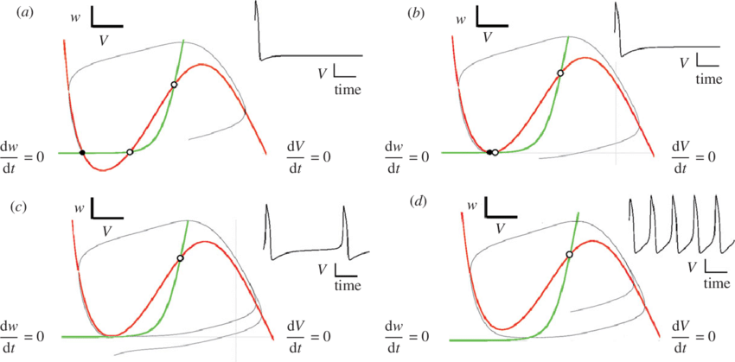
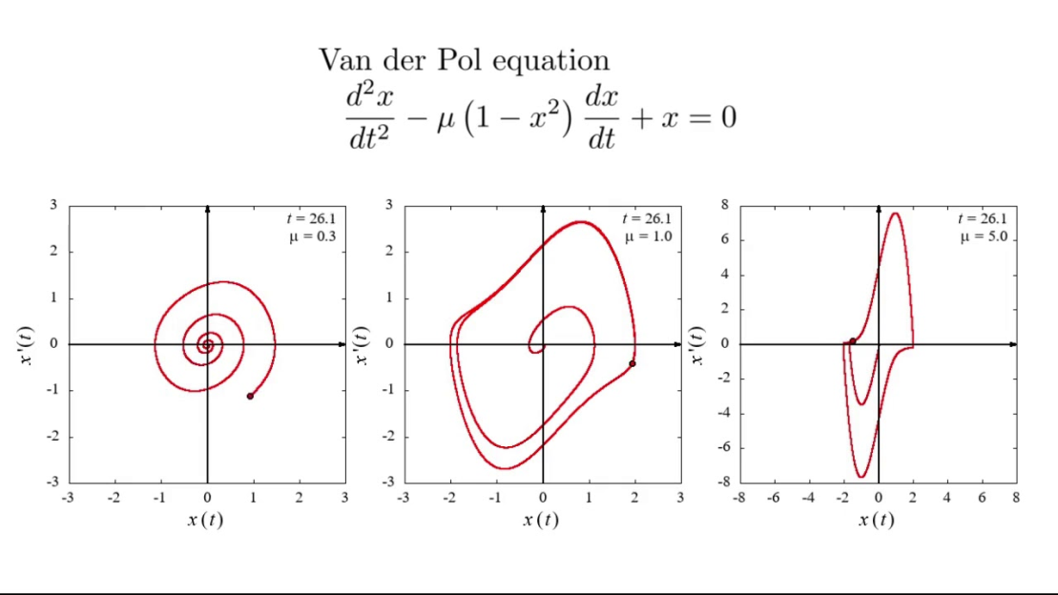
Morris-Lecarr model
Van Der Pol model

Slide 27
Oscillation as a model
of an Action Potential
Oscillation as a model
of Local Field Potential
The same models have been used for both

Slide 28
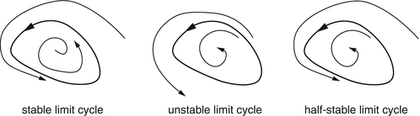
LIMIT CYCLES - LINEAR
TWO KINDS OF OSCILLATOR MODELS – LINEAR AND NONLINEAR
Definition: A limit cycle is a closed trajectory in phase space having the property that at least one other trajectory spirals into it either as time approaches infinity or as time approaches negative infinity.
Can only be exhibited by nonlinear systems.

Slide 29
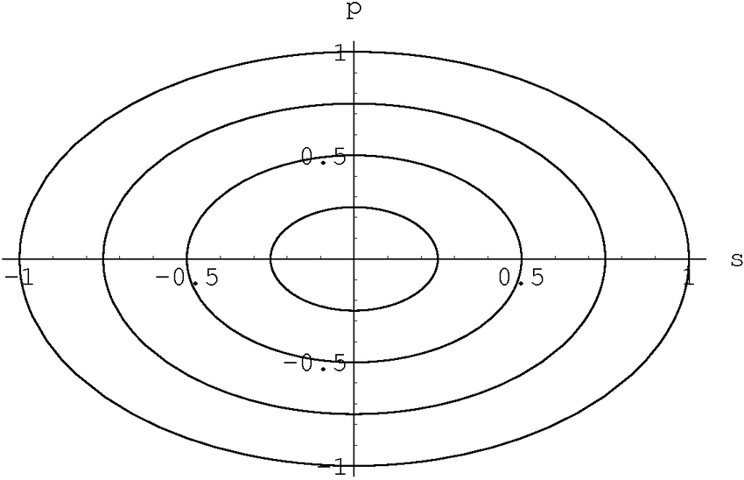
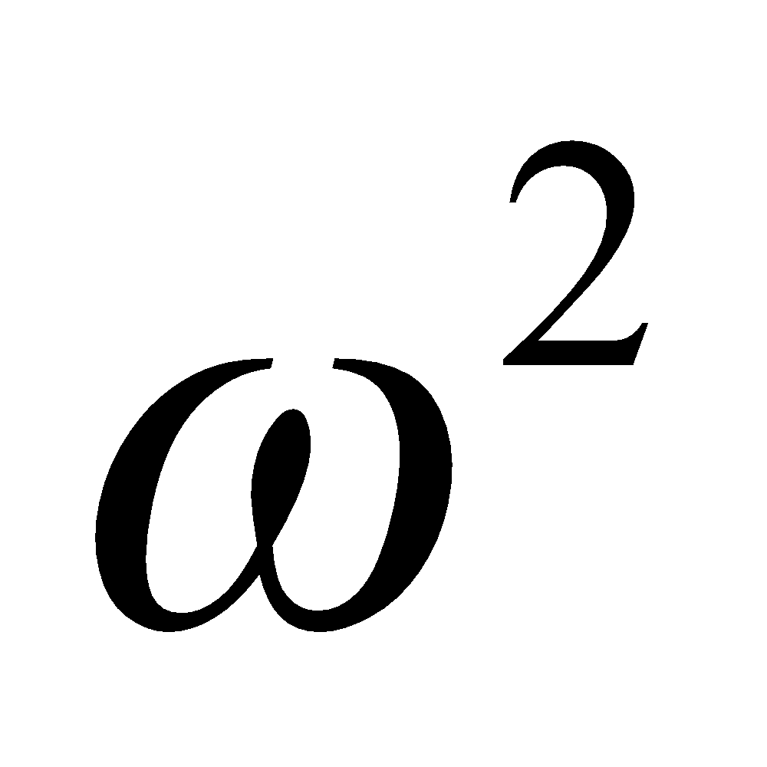
HARMONIC OSCILLATOR - LINEAR
Two-variable form:
dx/dt = f(x,y) = wy
dy/dt = -wx
d²x/dt² = -w² x
Solution is strictly dependent on the initial condition
Neural oscillations are Limit Cycle type

Slide 30
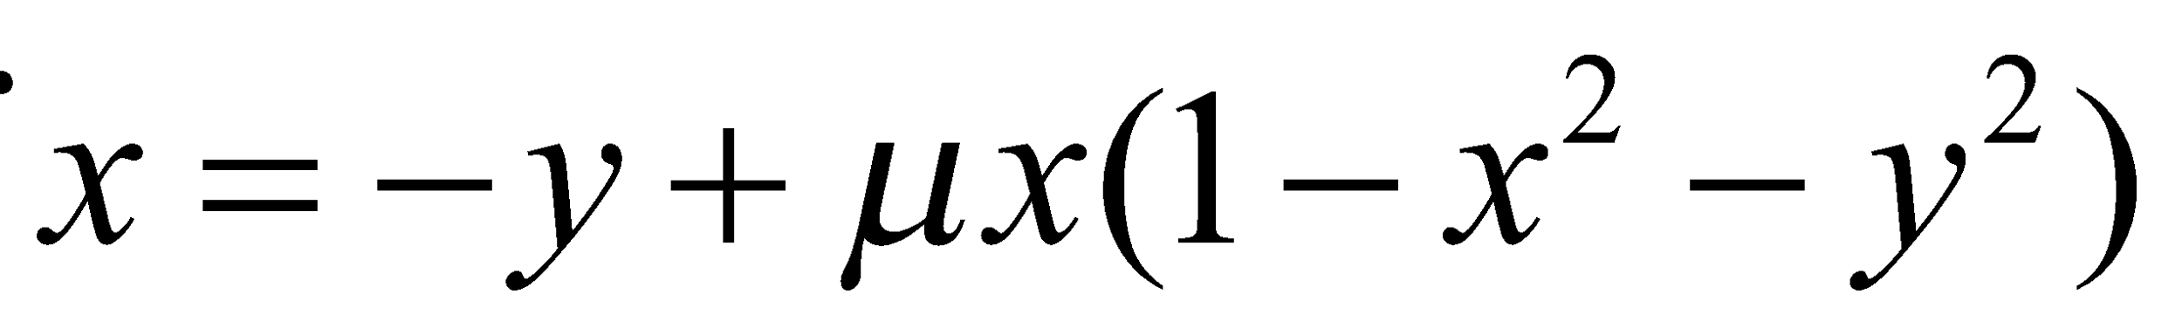
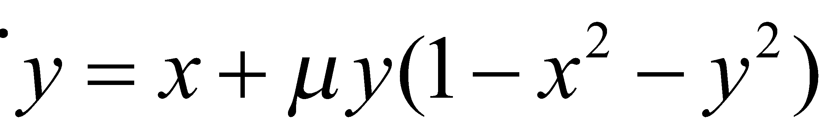
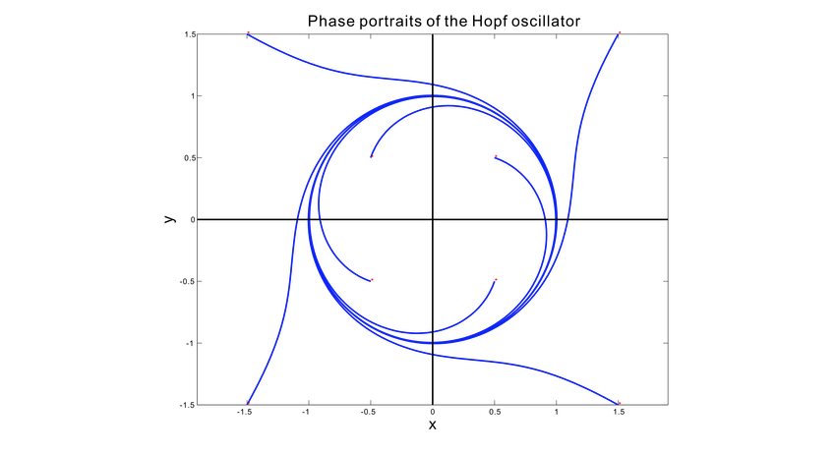
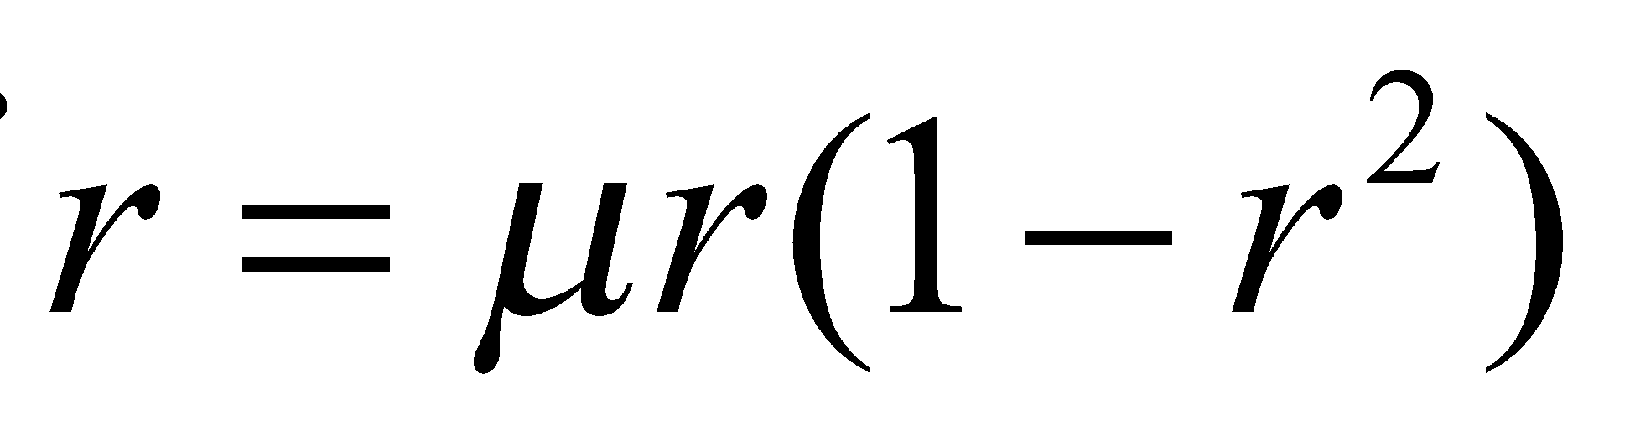
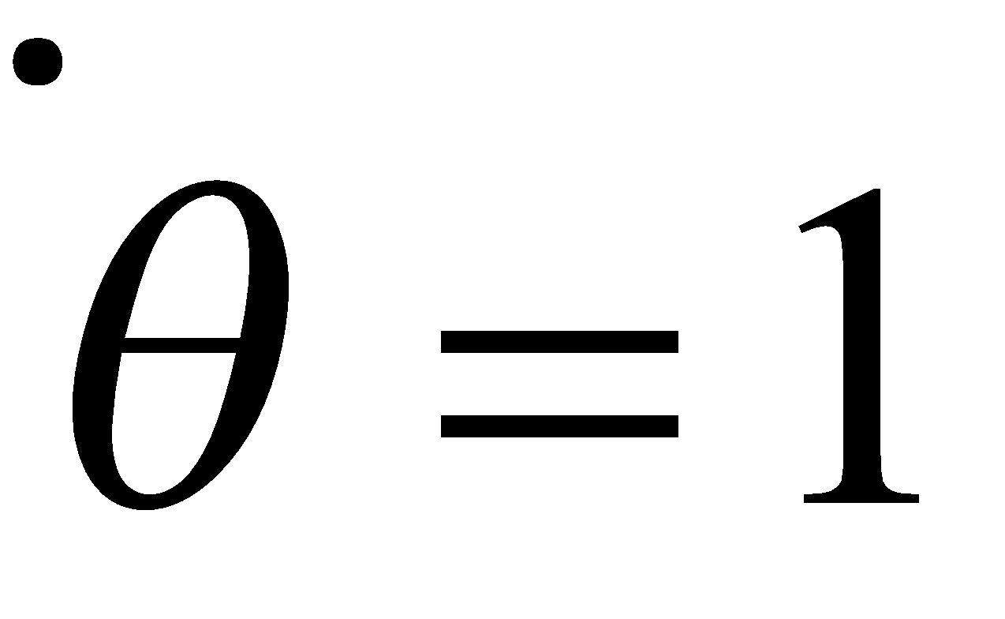
HOPF OSCILLATOR
In polar coordinates the equations have an elegant form.
Let x= r cos(θ), y = r sin(θ)

Slide 31
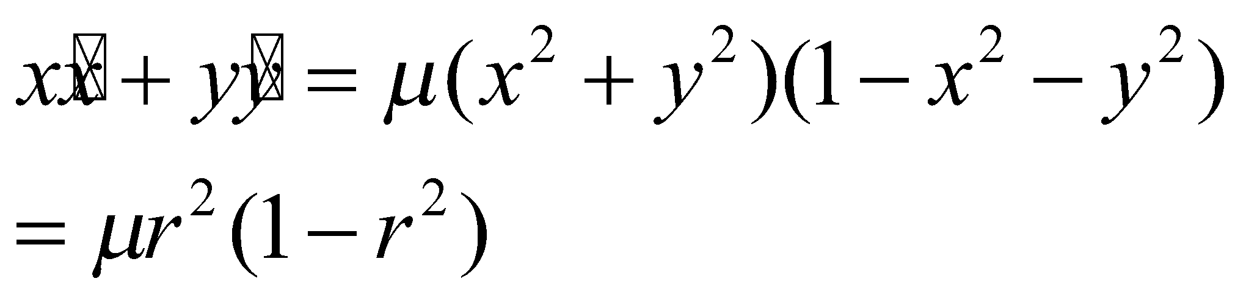
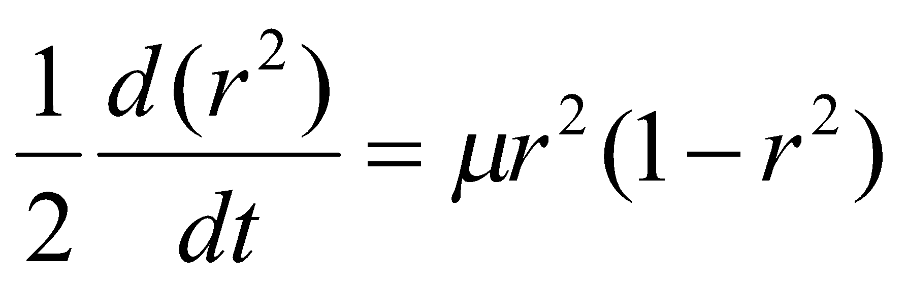
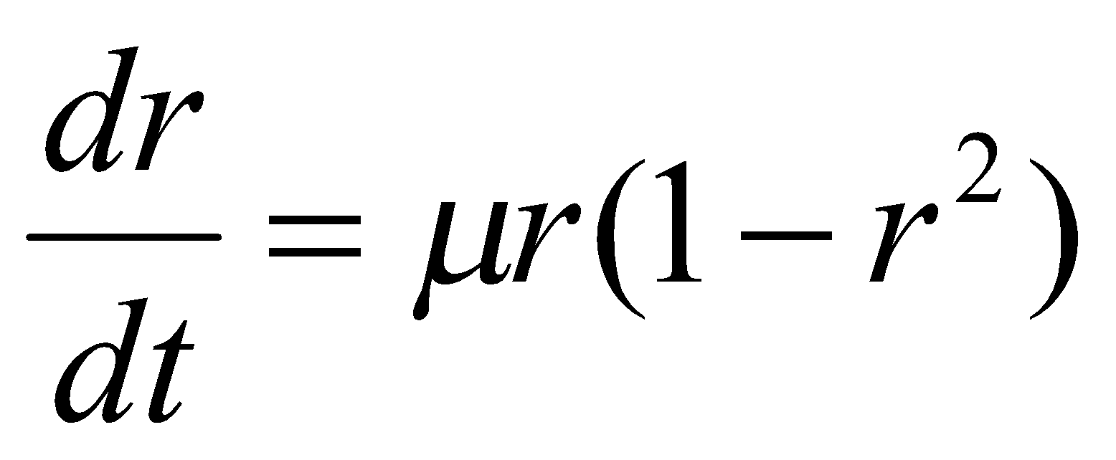

Slide 32
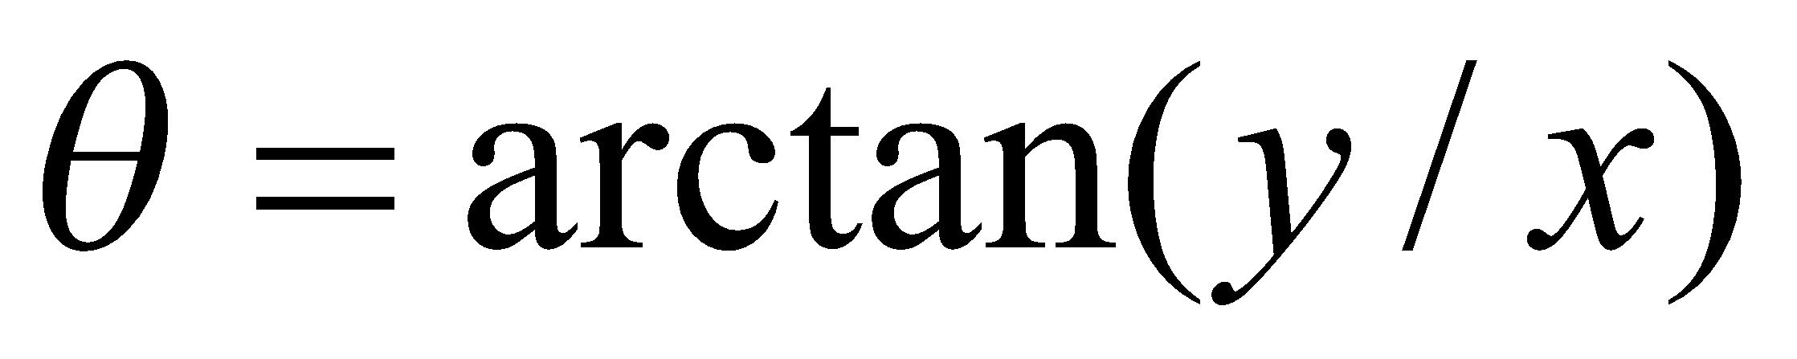
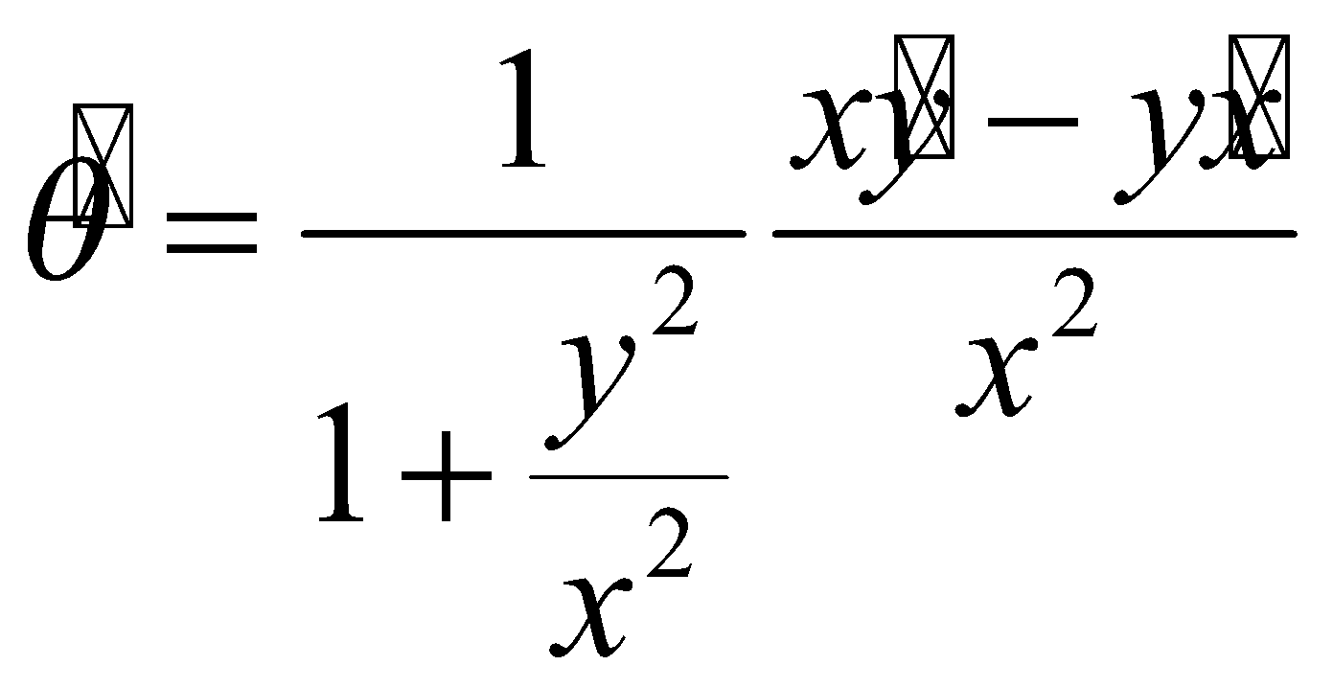
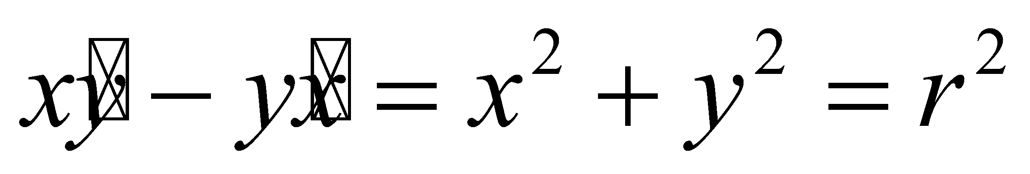

Now consider,
Differentiating both sides,

Slide 33








IN COMPLEX VARIABLE FORM
z=x+iy
Let
Equating real and
imaginary parts:

Slide 34






NO NONLINEARITY 🡪 SHM
Eliminating nonlinearity…

Slide 35
RESEARCH AGENDA
To construct general oscillatory neural networks using Hopf Oscillators:
Oscillatory Hopfield networks (done)
Oscillatory Auto Encoders (done)
Oscillatory Self-organizing Maps (SOMs)
Oscillatory Deep networks
Oscillatory Convolutional Networks etc etc

Slide 36

PROBLEM #0: SINGLE OSCILLATOR WITH SINUSOIDAL INPUT - FREQUENCY TUNING (RESONANCE)
(Kim and Large 2015)

Slide 37





PROBLEM#1 A PAIR OF COUPLED HOPF OSCILLATORS
What is the effect of
the Coupling Strength (W) on the Phase Difference (ψ)?

Slide 38






Slide 39







Slide 40

THEORETICAL EXPLANATION

Slide 41


NUMERICAL RESULTS

Slide 42




COUPLING TWO HOPF OSCILLATORS NEARBY FREQUENCIES, REAL COUPLING

Slide 43







Slide 44



COUPLING TWO HOPF OSCILLATORS WITH ARBITRARILY DIFFERENT FREQUENCIES
phase diff (Ψ) = const?

Slide 45

COUPLING TWO HOPF OSCILLATORS: ARBITRARILY DIFFERENT FREQUENCIES , REAL COUPLING GENERAL SCENARIO
ARNOLD TONGUES

Slide 46

NORMALIZED PHASE DIFFERENCE

Slide 47
How to achieve constant normalized phase difference for arbitrary frequencies?
Answer:
It requires a trick called
Power coupling

Slide 48




TRANSFORMING TRANSMITTER FREQUENCIES TO RECEIVER FREQUENCY

Slide 49



How to transform ω₁ to ω₂?

Slide 50

POWER COUPLING
Frequency of oscillator 1 is transformed into frequency of oscillator 2, as the signal passes over the connection

Slide 51

THEORETICAL ANALYSIS

Slide 52


Slide 53




Slide 54




Slide 55

BIOLOGICAL INTERPRETATION

Slide 56
TRAINING

Slide 57








FREQUENCY TRACKING
The intrinsic frequency of the oscillator can track the input frequency
(Righetti et al 2005)
Before Training
After Training

Slide 58









Slide 59

COUPLED N-OSCILLATOR NETWORK
Reconstructing a time series
By taking a weighted sum of outputs
of N-oscillator network
P_{teach}(t)

Slide 60


RECONSTRUCTING A TIME SERIES

Slide 61




TEST CASE#1 THE INTRINSIC FREQUENCIES OF THE OSCILLATORS LEARNED THE FREQUENCY COMPONENTS OF THE INPUT SIGNAL

Slide 62



GENERALIZED NETWORK#2 FROM LEARNING FREQUENCY SPECTRUM REPRESENTATION TO MODELLING ARBITRARY M NO OF TIME SERIES SIGNALS HAVING SAME FREQUENCY COMPONENTS PRESENT IN THE SIGNAL USED TO TRAIN NETWORK#1

Slide 63

MODELLING ELECTROENCEPHALOGRAPHIC SIGNAL USING NETWORK#2
(Biswas, Pallikkulath & Chakravarthy, 2021)

Slide 64

PHASE #1 NETWORK LEARNS THE FREQUENCY SPECTRUM OF A EEG SIGNAL COLLECTED FROM ONE ELECTRODE AND IN THE PHASE #2: NETWORK LEARNS TO RECONSTRUCT N- EEG CHANNELS

Slide 65

RECONSTRUCTION ACCURACY INCREASES WITH #OSCILLATORS IN THE NETWORK

Slide 66

2. LARGE SCALE BRAIN MODELS
The Virtual Brain (TVG)
(TVB)
- Network of Wilson-Cowan
Oscillators
- Connections computed by
General optimization
https://www.thevirtualbrain.org/tvb/zwei

Slide 67

A DICHOTOMY
Oscillatory Brain models e.g. TVB
Can model brain dynamics
Cannot model Behavioral
I/O Functions
Deep Neural Networks
Cannot model brain dynamics
Can model Behavioral
I/O Functions
Is there a single modeling approach
that can achieve BOTH?

Slide 68



LARGE SCALE BRAIN MODELING USING OSCILLATORY NEURAL NETWORK
Hopf
Oscillator

Slide 69

Modeling of multichannel EEG signals
Reconstructed Signals
Oscillator Layer
Hidden Layer
Electrode Names and Labels
(With Sayan Ghosh)

Slide 70


Slide 71








62 channels wake Data reconstruction(10 sec)
Yd(t)-Desired signal,Yp(t)- Predicted Signal
RMSE: 0.0354
RMSE: 0.0317
RMSE: 0.0417
RMSE: 0.0406
RMSE: 0.0301
RMSE: 0.0277
RMSE: 0.0352
RMSE: 0.0391
Data Courtesy: Dr Sujith Vijayan, Virginia Tech.

Slide 72





RMSE: 0.0356
RMSE: 0.0314
RMSE: 0.0370
RMSE: 0.0287
Channel Wise Error Profile
RMSE of all channel at the end of 5000 epoch
62 channels wake Data reconstruction(10 sec)
Yd(t)-Desired signal,Yp(t)- Predicted Signal
(manuscript in preparation)

Slide 73
FROM STRUCTURAL CONNECTIVITY TO FUNCTIONAL CONNECTIVITY: A PHENOMENOLOGICAL WHOLE BRAIN MODEL
Anirban Bandyopadhyay,
Sayan Ghosh,
Neuroimage Team
With
Prof. S. Bapiraju
IIIT Hyderabad.

Slide 74








DTI
Tractography
Optimization
Correlation Coefficient
Power
Coupling
Structural Connectivity
Functional
Connectivity

Slide 75


Basic Model Architecture:
First stage of learning
Second stage of learning

Slide 76
Normalized Structural Connectivity

Slide 77

Main Model Architecture:
Structural Connectivity based BOLD signal Learning Model

Slide 78

Simulated result for ROI 1 and ROI 2
(Bandhopadhyay et al, Scientific Reports, 2023)

Slide 79


3. TONOTOPIC MAP MAP OF SOUNDS OR FREQUENCIES
Frequency
~
~
~
~
Fourier Series
~
~
~
~
Phase
~
~
~
~
~
~
~
~

Slide 80


FOURIER DECOMPOSITION IN COCHLEA

Slide 81

AUDITORY CORTEX OF BATS
(Suga 1990)
http://nelson.beckman.illinois.edu/courses/neuroethol/models/bat_echolocation/bat_echolocation.html

Slide 82
ω₁
ω₂
ω_{i}
ω_{i+1}
ω_{N}
ω closest to ω_{i}
Fe^{iωt}
Resonance!

Slide 83

HOPF OSCILLATORS EXHIBITS RESONANCE
ze^{iωt}
ω₀
Fe^{iωt}
Ω=ω−ω₀
(Kim & Large 2015)

Slide 84

OSCILLATORY TONOTOPIC MAP MODEL
(Biswas, Chakravarthy, Tarasode, Frontiers in Comp Neuro, 2022)

Slide 85

MODIFIED POWER COUPLING

Slide 86


Slide 87

MAP RESPONSE
Response to a single frequency
Response to a two frequencies

Slide 88


Slide 89

4. HARDWARE OSCILLATORS FOR QUADRUPED LOCOMOTION
(with Akhil Bonagiri and Dipayan Biswas)

Slide 90

SIMULATED I-V CHARACTERISTICS OF THE MEMRISTOR

Slide 91

MORRIS-LECAR VS VO2 OSCILLATOR
(Bonagiri et al, IEEE Trans on Neural Networks and Learning Systems, 2023)

Slide 92

MODELING LOCOMOTOR RHYTHMS
https://doctorlib.info/physiology/medical/88.html

Slide 93


Slide 94


5. GENERALIZED OSCILLATORY DEEP NEURAL NETWORKS
r and ϕ are the state variables of oscillator
𝐖ⱼⁱ - weight connecting oscillators i and j
ε - Scaling parameter for input signal I(t)

Slide 95


Autoencoder - reconstructing input signal
Fig: Reconstructing signals (blue - generated, orange - desired)

Slide 96


Integration
Input and output data generation
Fig: Output signals - integration of input signal (blue - generated, orange - desired)

Slide 97


AMPLITUDE DEMODULATION
𝑴(𝒕) = (𝑨_{𝑪}(𝙩) + 𝙢(𝙩)) 𝘀𝗶𝗻(ω_{𝐂}𝙩) : m(t) = ∑ Α_{m}sin(ω_{m}t)
Fig : Some sample message signals, m(t), (left panel), and Modulated signals, M(t), (input to the model.)
Fig : Sample demodulated signals: Model predicted (Blue), Desired (orange)

Slide 98


AN OSCILLATOR THEORY OF BRAIN FUNCTION
BASIC SCIENCE
Oscillations in
Spatial Navigation
Oscillations in
Sensory Processing
Oscillations in Attention
Oscillations in
Memory
Oscillations in
Motor Function
Oscillations in
Autonomic control
Oscillations in
Mood
Oscillations in
Brain disorders

Slide 99


ANALOGY BETWEEN RADIO COMMUNICATIONS AND THE BRAIN
3 Hz – 3,000 GHz
0.1 Hz – O(100) Hz

Slide 100

THE PROBLEM OF FREQUENCY ALLOCATION IN THE BRAIN
Is there a gradient?
Frequency Gradient
What is the
frequency distribution
that emerges?
(Mahjoory et al, eLife, 2020)

Slide 101
ACKNOWLEDGEMENTS
Dipayan Biswas
Aasit
Surya Kiran
Shreyas
Anirban
Sayan
Rohan

Slide 102

Thank you

